Slide 1
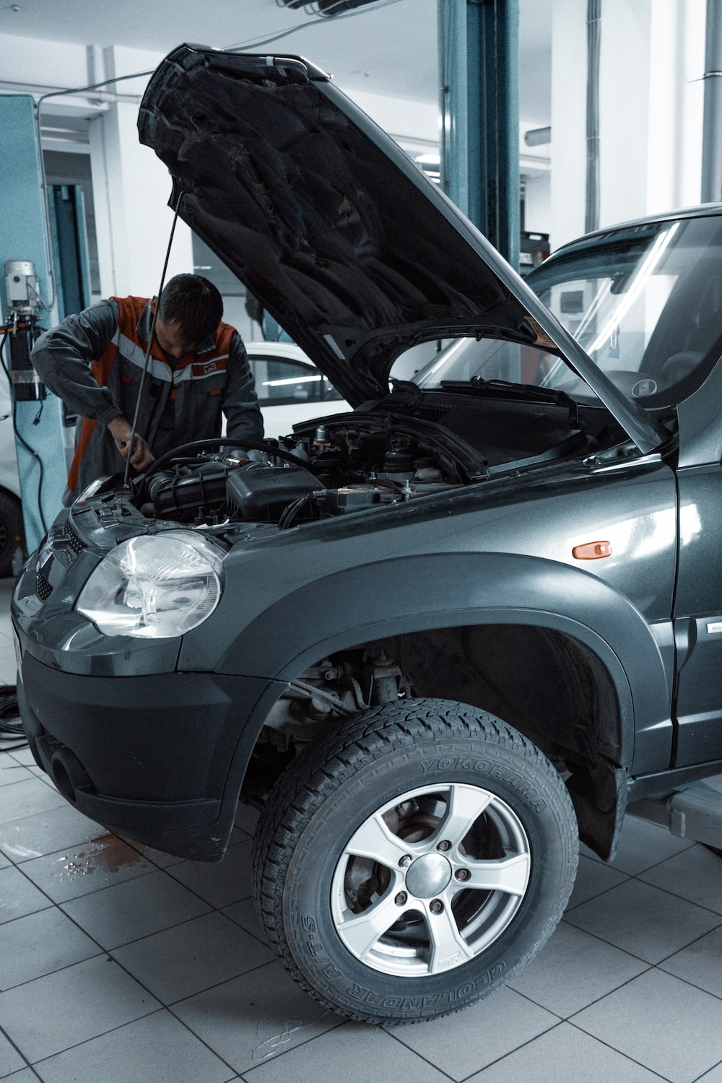
CAR CARE
“
Submitted By:
Akshay Anish
22PMC104

Slide 2
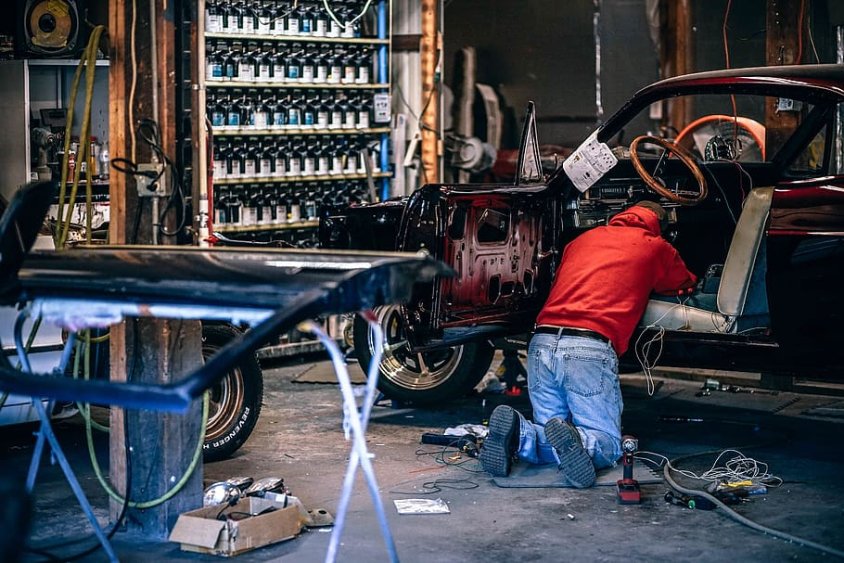
ABSTRACT
Car Care is a vehicle service management system web app. Developed using Python Django and SQLite database. Designed to efficiently manage vehicle service requests and facilitate communication between customers, administrators, and mechanics. Car Care aims to simplify the process and improve customer satisfaction.

Slide 3
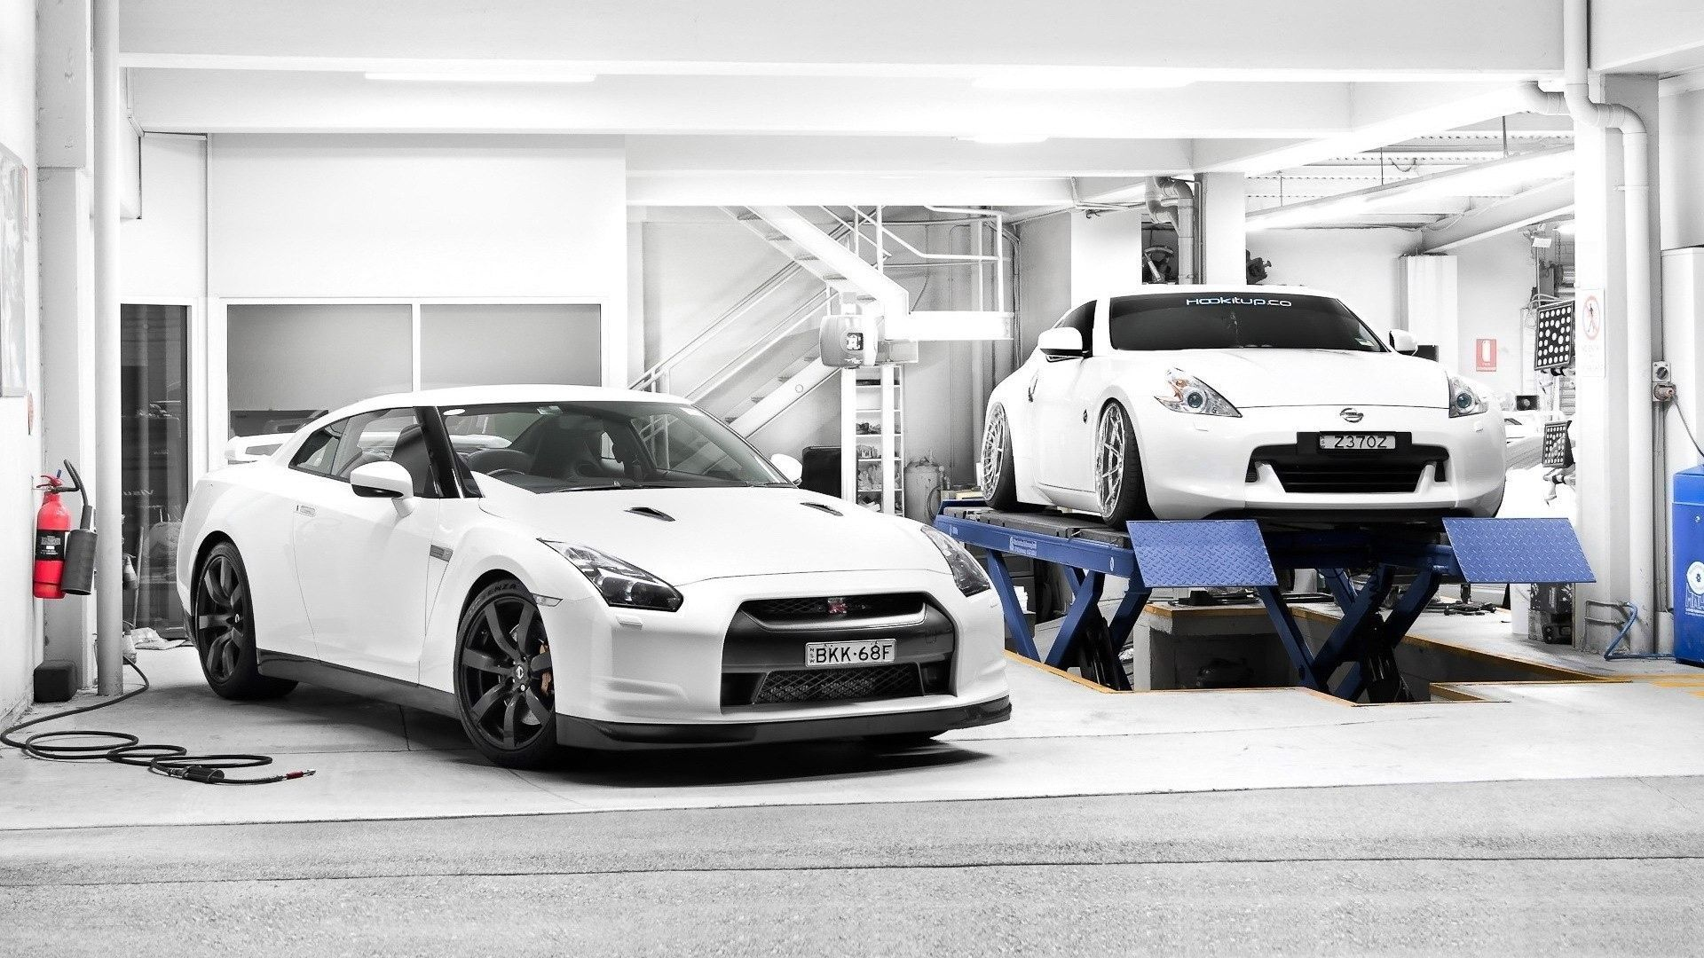
PROJECT REQUIREMENTS
User registration for Customers And login functionality for all users
Customer can request for Service
Customer can view service Status
Customer can view invoice
Customer can Send feedback
Admin can add and manage mechanics
Admin can approve service request and Assign job to Mechanic
Admin can update service status
Admin can view customer’s and mechanics feedback
Mechanic can view work assigned
Mechanic can update the service status
Mechanic can send feedback according to the work done
“

Slide 4

FEATURES AND HIGHLIGHTS OF THE PROJECT
Service Request Submission
Track Status
Cost Estimation
Feedback Submission
Administrative Control
Mechanics Work Management
User-friendly Interface

Slide 5
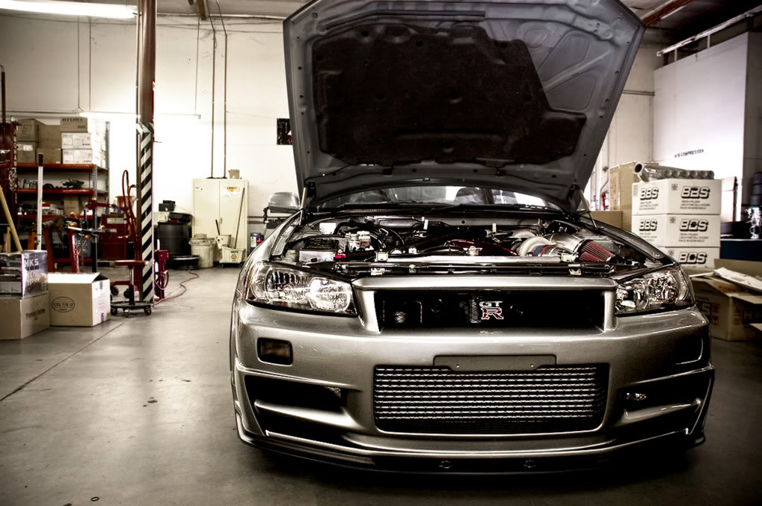
TECHNICAL ASPECTS
Programming Language
Web Framework
Frontend Framework
Database(SqLite3)
Bootstrap
3rd party libraries

Slide 6
ARCHITECTURE
Presentation layer:
The presentation layer includes the UI, Django templates, Jazzmin package. The UI interacts with users. Django templates render dynamic content. Jazzmin provides an interactive admin panel.
Application Layer:
Authentication and Authorization
Service Request Management
Service Scheduling
Database Layer:
Customer Database
Service Request Database

Slide 7
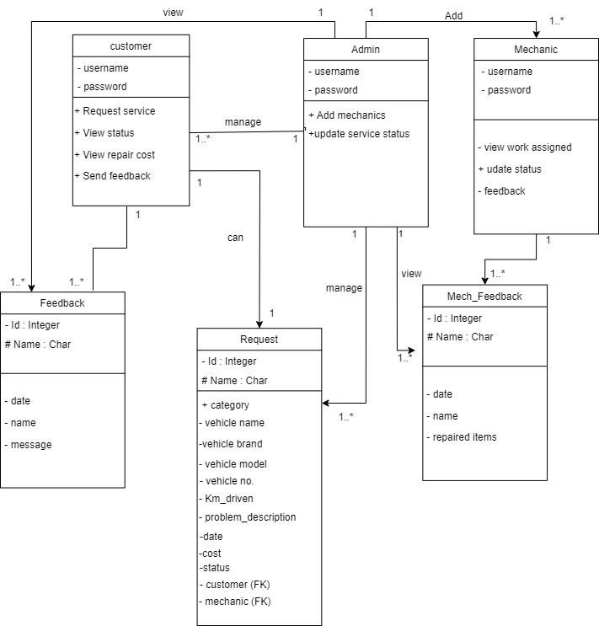
CLASS DIAGRAM

Slide 8
CHALLENEGES FACED
“
User Experience and User Interface:
Designing a user-friendly interface for Car Care is important but can be challenging. To overcome this, conduct user research, gather feedback, and make improvements based on user input. Ensure the interface is easy to use, responsive to different devices, and accessible to all users.
Coding the logic
Coding the logic behind Car care were really difficult. It was completed after days of coding and getting help from friends
Security and Authentication:
Implementing security measures for Car Care to protect user data, prevent unauthorized access, and ensure secure authentication can be challenging due to the need for encryption, authentication protocols, and access controls.

Slide 9
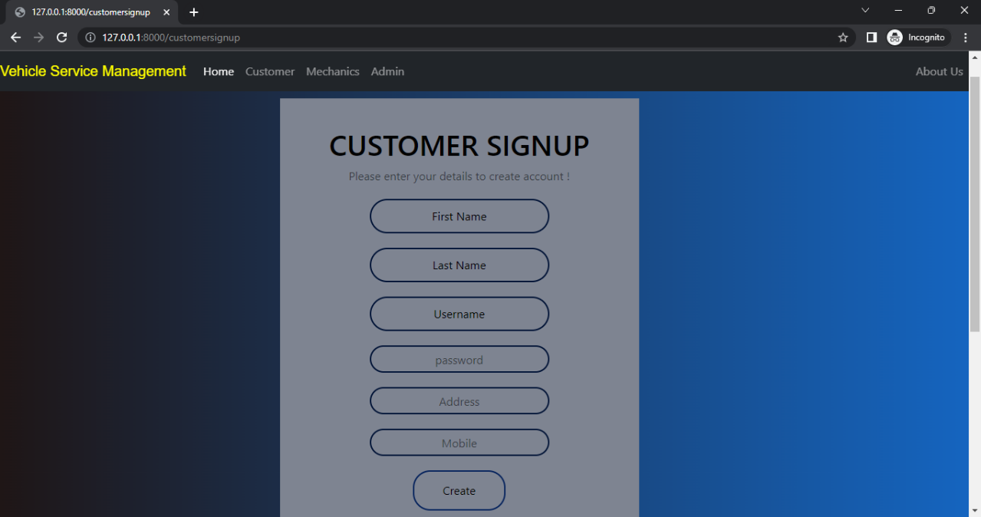
SCREEN SHOTS
CUSTOMER
SIGN UP
The provided screenshot shows the customer sign-up page of the web application. Here, customers can enter their personal information and create an account to access the various features available.

Slide 10
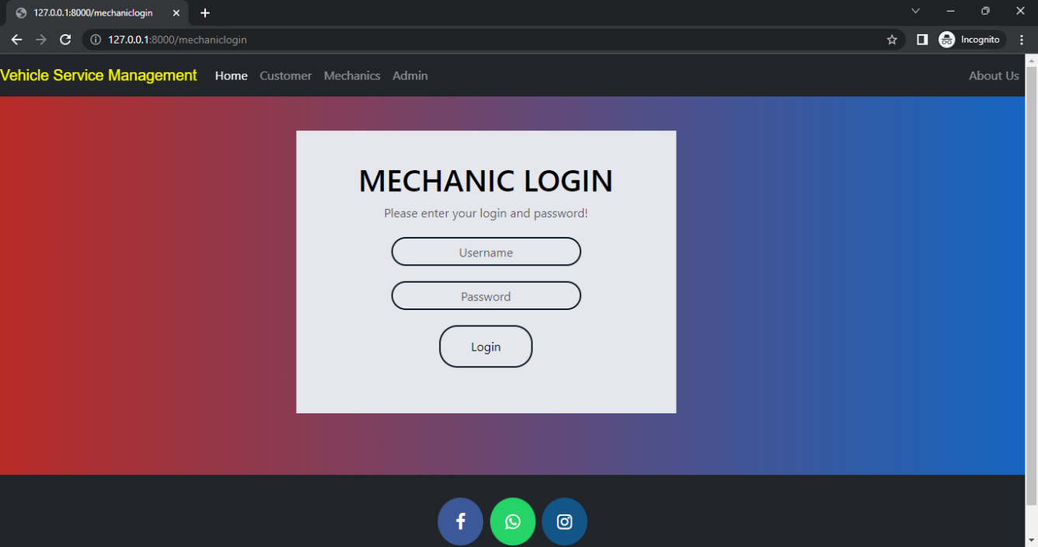
MECHANIC LOGIN
The provided screenshot shows the login page for mechanics in the web application. Mechanics can access the system by entering their unique username and password.

Slide 11
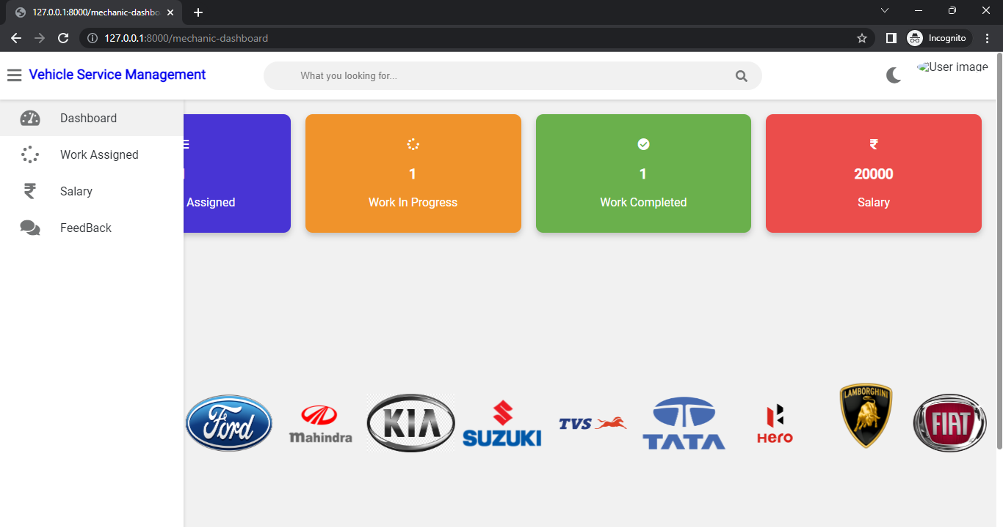
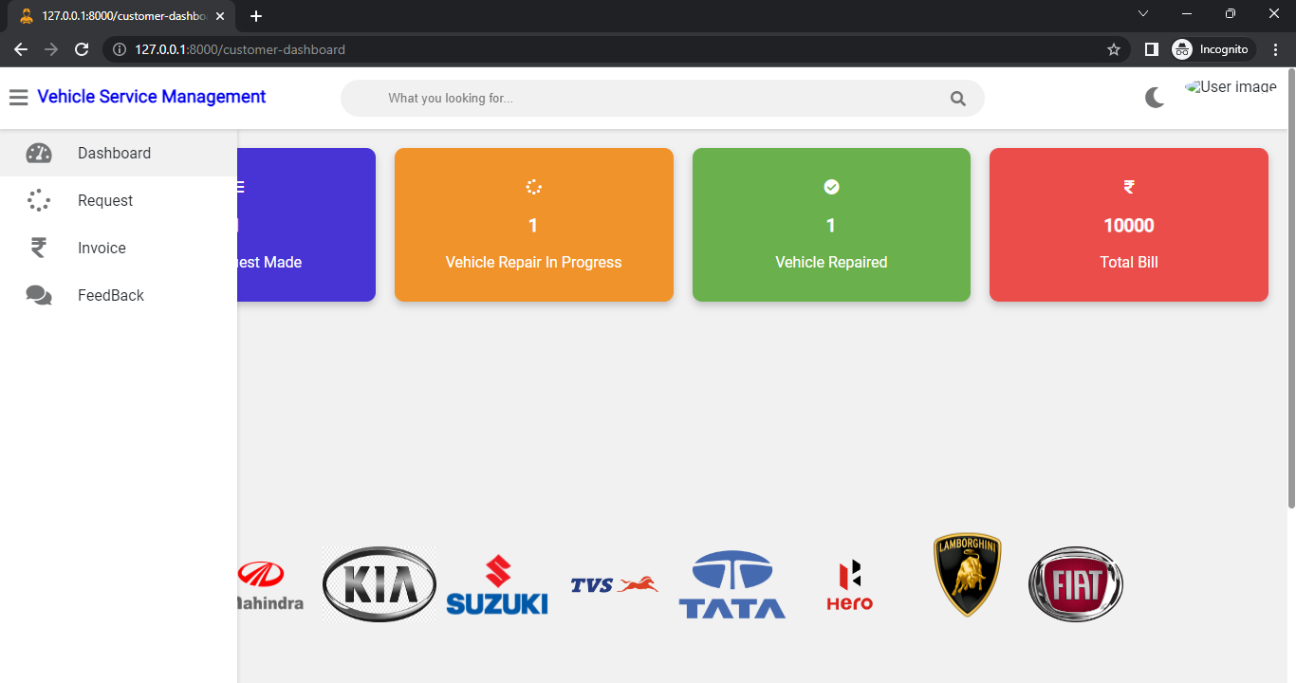
MECHANIC DASHBOARD
The screenshot provided showcases the mechanic dashboard, which is the main interface for mechanics within the web application.
CUSTOMER DASHBOARD
The screenshot provided showcases the customer dashboard, which is the main interface for customer within the web application.

Slide 12
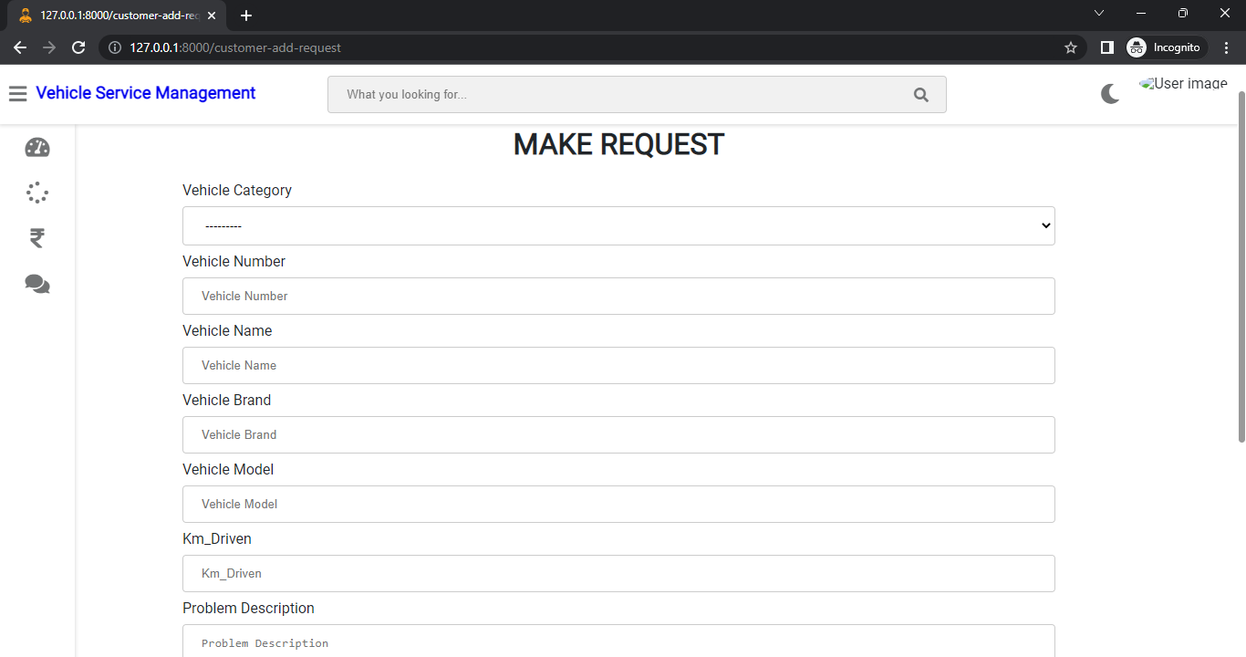
CUSTOMER REQUEST
This screenshot displays the page where customers can submit their requests for service.

Slide 13
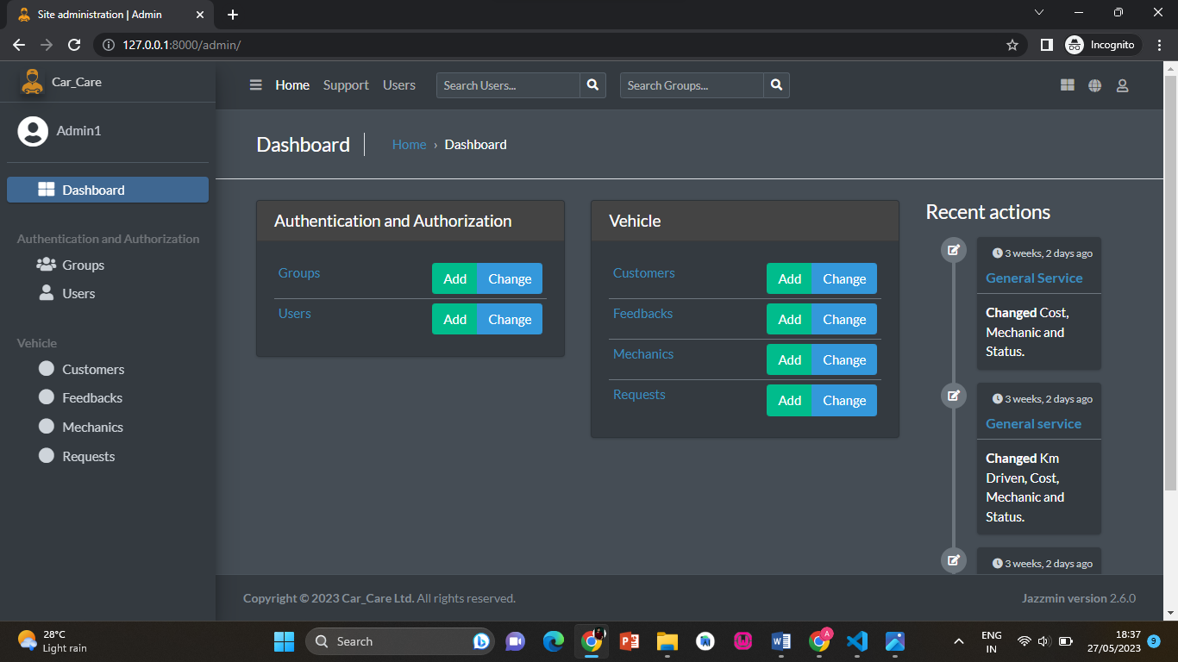
ADMIN DASHBOARD
This screenshot shows the main page of the administrative dashboard. It's a control panel where administrators can manage various aspects of the system and access important information and tools.

Slide 14
FUTURE ENHANCEMENTS
Mobile Application:
A mobile app version of the system can enhance accessibility and convenience. Customers, administrators, and mechanics can manage requests and provide feedback on the go.
Integration with Payment Gateways:
Integrating secure payment gateways can enable online payments for services, providing a seamless experience.
Service Reminder Notifications:
A feature that sends automated service reminders can help customers stay proactive in servicing their vehicles and ensure timely maintenance.

Slide 15

CONCLUSION
The project was completed successfully within the given time. Each module was tested individually and then integrated into the main system. We also conducted tests using real data, and everything worked smoothly. As a result, the system has achieved all the goals we set out to accomplish. Our aim of creating this car care system has been fulfilled, and we are pleased with the outcome.
GitHub Repository link of the project:https://github.com/akshayanish2610/MINI-PROJECT.git

Slide 16

REFERENCES
https://phpgurukul.com/vehicle-service-management-system-using-php-and-mysql/
https://www.youtube.com/watch?v=WrZ10AZYbv4&list=RDCMUC7dD1bOWXiJH3lJLsTInxOQ&start_radio=1&rv=WrZ10AZYbv4&t=0
https://docs.djangoproject.com/en/4.2/
https://django-jazzmin.readthedocs.io/

Slide 17
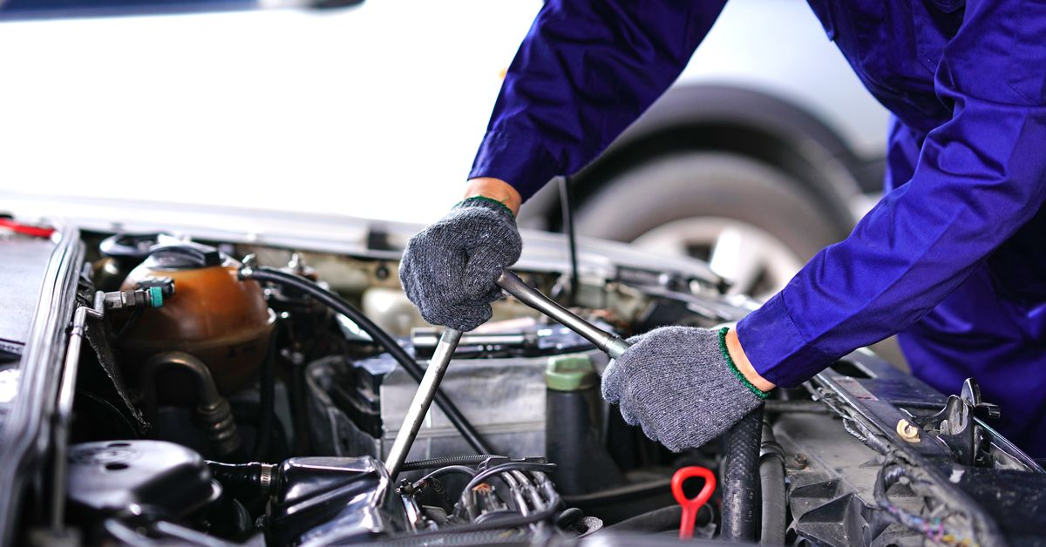
THANK YOU!
“

